Slide 1
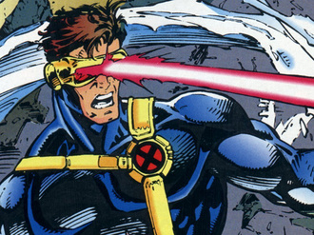
Laser Cat
Presented by:
Almeda Glenn Brandon Tan Troy Toh Lim Wei Heng
Credits are given to the pictures in this presentation

Slide 2
Disclaimer
Please note that the pictures provided in this presentation do not intend to infringe any copyright. Credits are given to the sources.

Slide 3
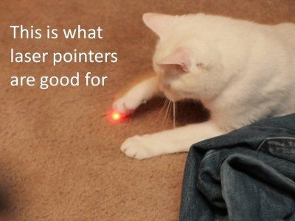

Slide 4
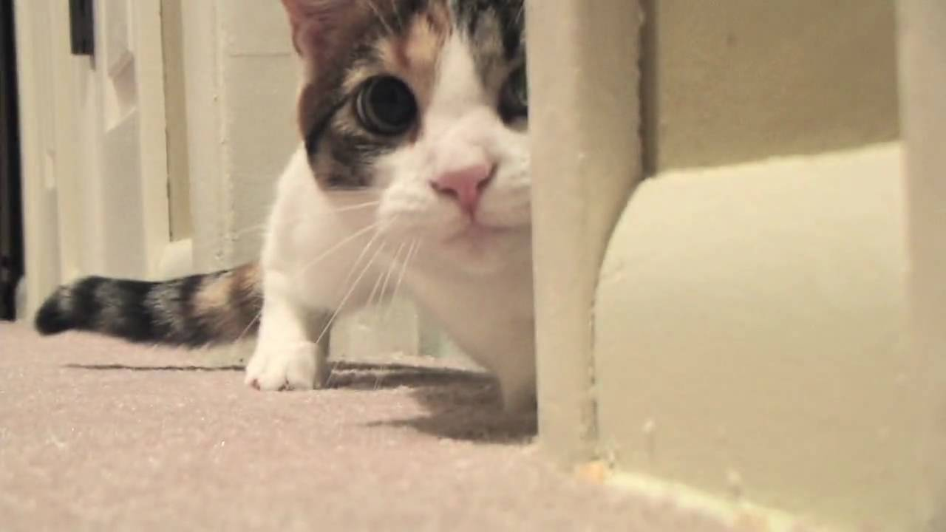
Overview
Gameplay Samples
Screenshots (Before & After)
Reviews(?)
Risks/Concerns
Random Inspirations
Q&A

Slide 5
Gameplay Samples

Slide 6
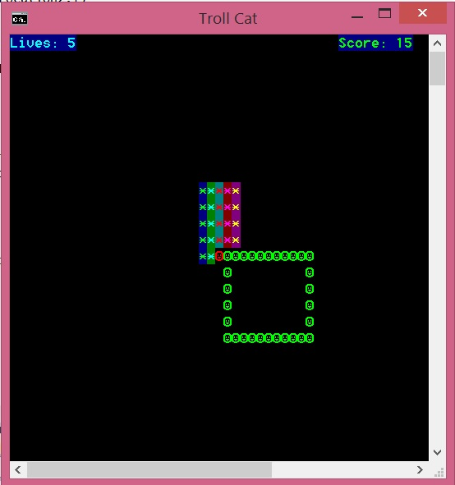
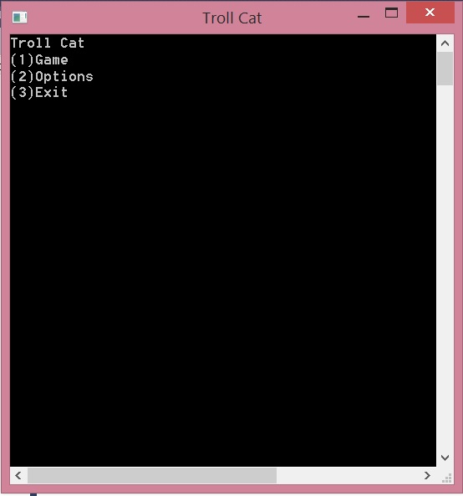
Screenshots (Before)
Initial Menu →
← Initial Gameplay

Slide 7
Screenshots (After)
//final product of the game

Slide 8

Risks/Problems/Concerns
//to brainstorm some potential issues we are aware of….

Slide 9
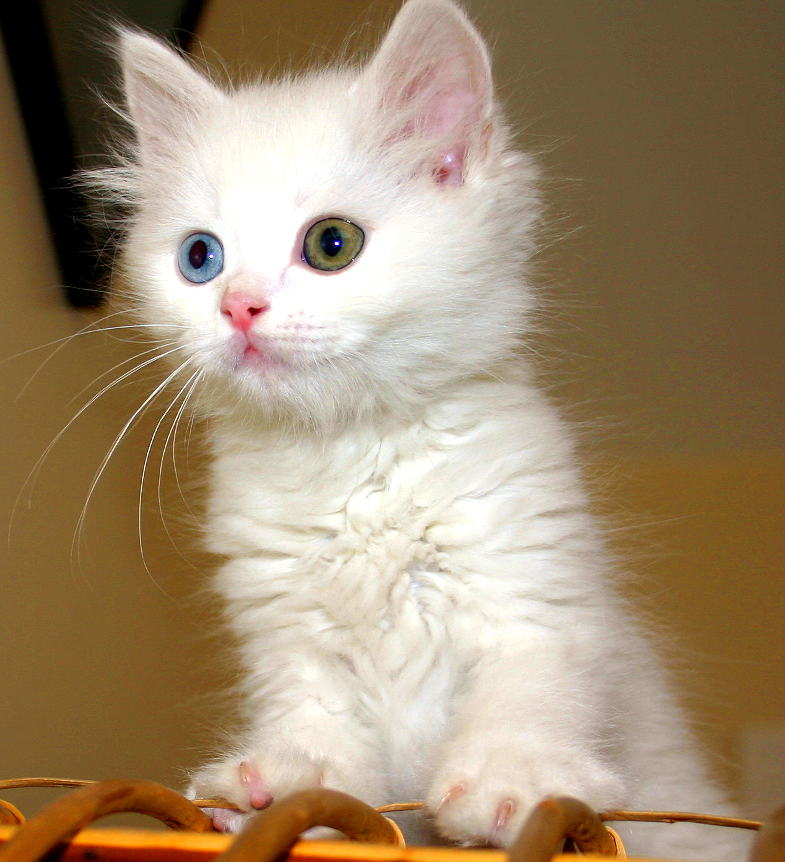
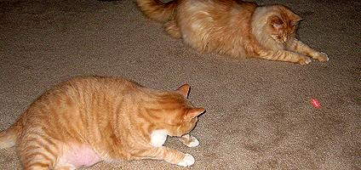
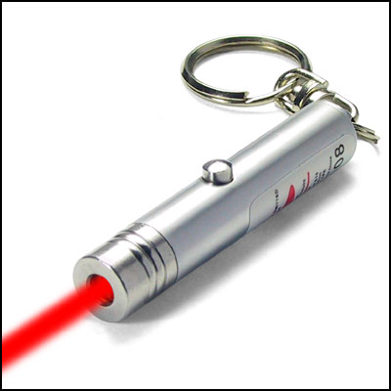
Inspirations

Slide 10
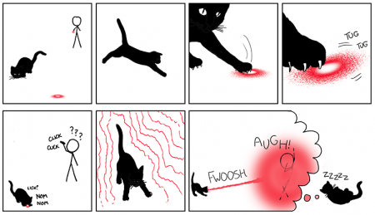
Inspirations

Slide 11
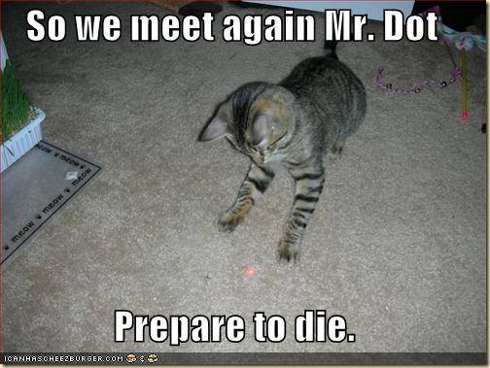

Slide 12
Thank You!!

